Slide 1
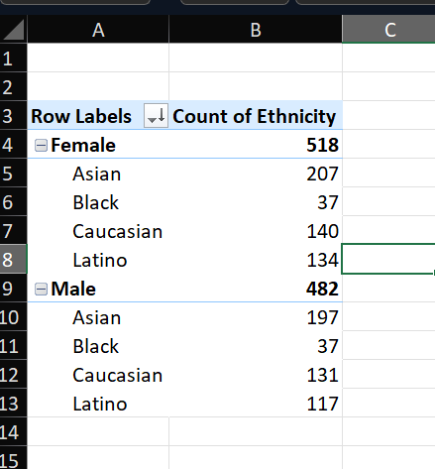
1.Provide summary of gender and ethnicity distribution
From the analysis it is observed that
There are more number of Female than Males in the company
The majority of the employees are also asians

Slide 2
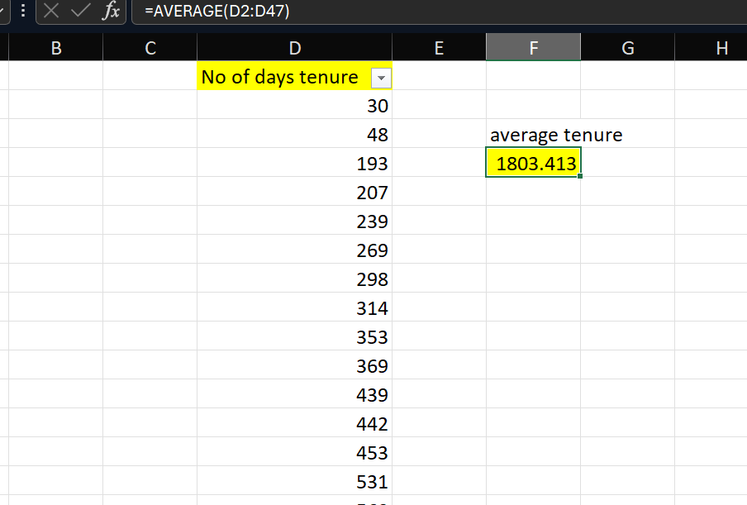
2.How long an employee stays in the company before leaving
Based on the analysis the employee data,
The average tenure of employees before
The company is around 1803.413 days

Slide 3
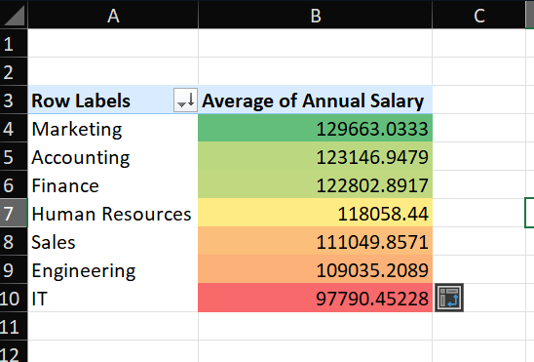
3.Is there a significant diff between diff departments and avg salaries
Based on the Analysis,
1) Marketing dept has highest avg salary followed
By accounting and finance.
2) While the least avg salaries are of IT,Engineering
And Sales

Slide 4
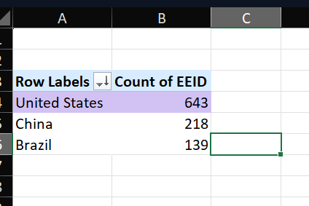
4.Which company has the highest number of employees
It is clear from the data that United States has
The highest number of employees followed by
China and Brazil

Slide 5
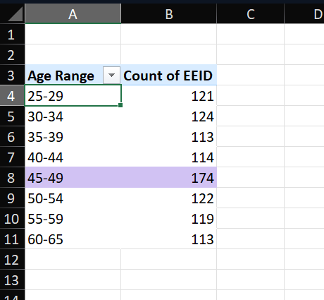
5. The most common age range of employees
The most common age range of employees is
Between 45-49 years.

Slide 6
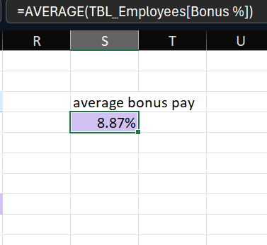
6. Average bonus percentage given to the employee
From the analysis it is observed that
The average bonus percentage given to employees is 8.87%

Slide 7
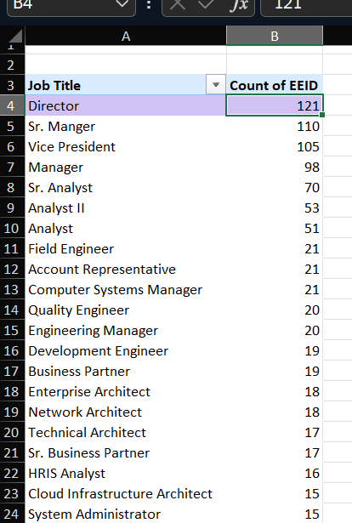
7.Which Job title occurs most frequently in the dataset
From the data from pivot table,
There are more number of people with the designation
As Director.
2) These are followed by Sr.Manager and Vice President
3) The least job titles are automation engineer and Network
Engineer

Slide 8
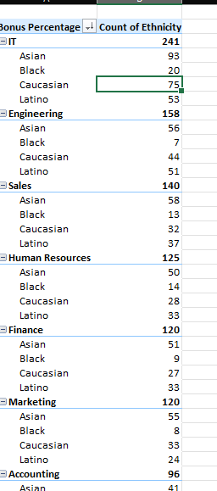
9. Diversity in departments

